Slide 1

MOBILE DEVELOPMENT
COMPUTER SCIENCE
Topic 10:
Mobile App Deployment
version 1.0
Copyright © 2020 by Singapore Institute of Management Pte Ltd. All rights reserved.

Slide 2

Learning Outcomes
After studying this topic and the recordings online, you should be able to:
Topic 10 – Mobile App Deployment
What is App Deployment?
What is Code Signing?
Exporting an expo build

Slide 3

What is app deployment?
Today, more than 4 million applications are available for download on Google Play Store and Apple App Store.
Making both platforms the key to outreach more users.
Notes:
B

Slide 4
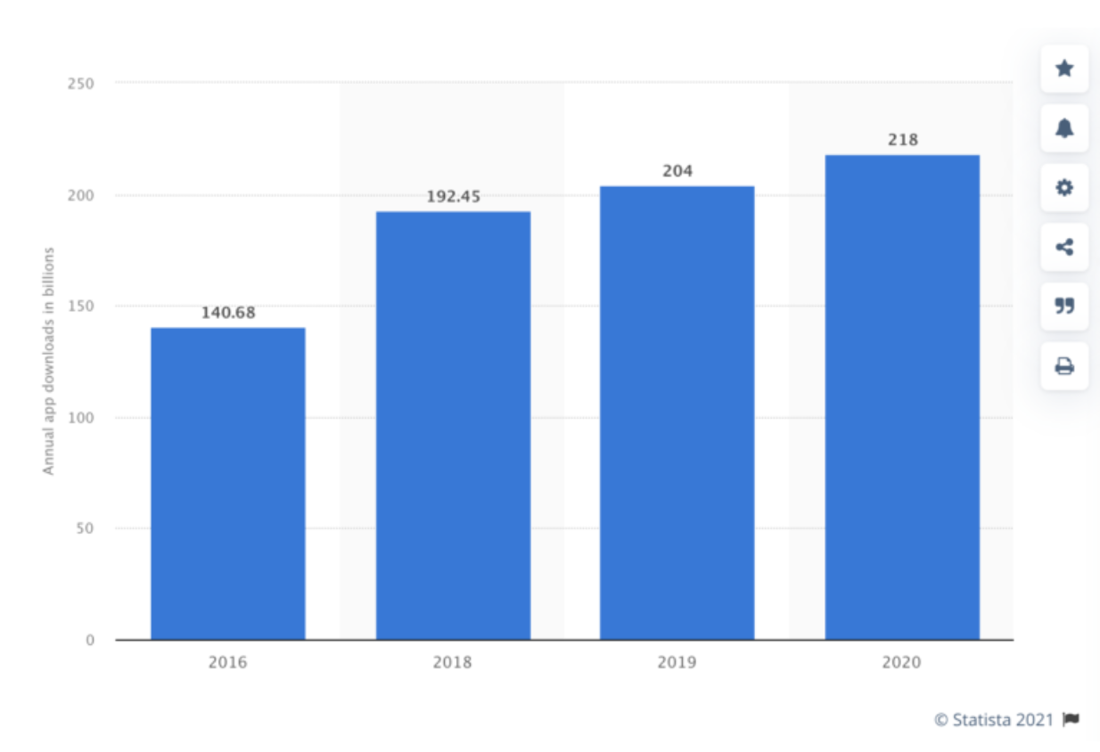
What is app deployment?
Reference from (buildfire, Mobile App Download Statistics & Usage Statistics (2022))
Notes:
B

Slide 5
What is app deployment?
Based on the earlier diagram:
We are seeing growth in app downloads each year. This trend will continue in the coming years as well.
Last year, there were more than 218 billion app downloads. That’s roughly a 7% increase from the year prior.
As you can see from the graph, there was a 55% jump between 2016 and 2020. The year over year growth rate isn’t quite as sharp, but it’s still on the rise.
Notes:
B

Slide 6
What is app deployment?
Google Play vs. App Store Downloads
There are TWO (2) places where the overwhelming majority of mobile users are downloading apps.
Users with iOS devices download iPhone apps from the Apple App Store, while Android app users download from the Google Play Store.
Notes:
B

Slide 7
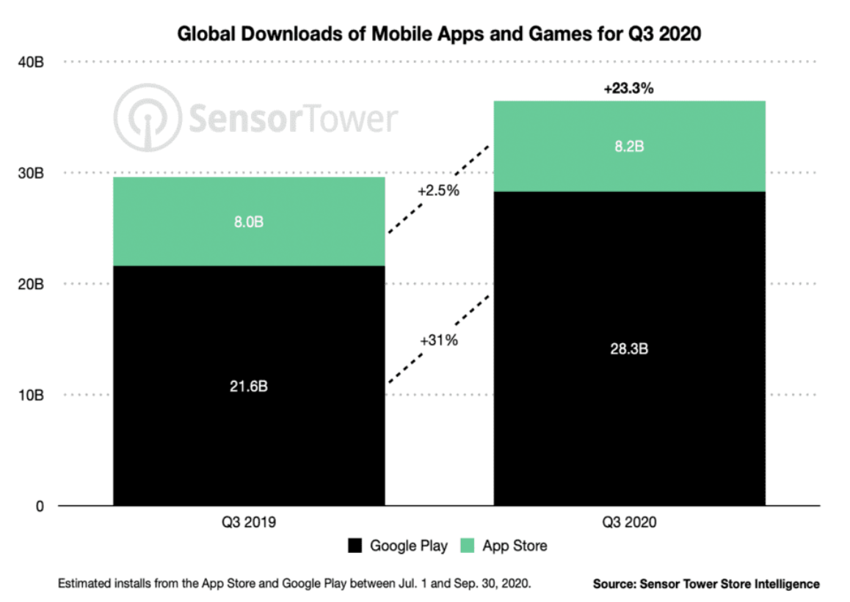
What is app deployment?
Google Play vs. App Store Downloads
Notes:
B

Slide 8
What is app deployment?
Google Play vs. App Store Downloads
Worldwide, there are more downloads coming from the Google Play Store. But as you can see, both stores saw an increase in the percentage of downloads from 2019 to 2020.
The Google Play Store downloads grew by 31%, while the Apple App Store had just a 2.5% growth rate.
In short, the Google Play Store has more downloads and is growing at a higher rate.
Notes:
B

Slide 9
What is app deployment?
App deployment and launch is the process of installing, configuring, and allowing a particular app or a set of apps to observe a successful release on public or enterprise app stores.
It involves pragmatic steps and activities to make a software system available to the target audience.
Notes:
B

Slide 10
What is app deployment?
Currently, most organizations and app developers deploy new applications, patches, and software updates with an automated/manual processes.
Thus, its important to understand the deployment guidelines from Google and Apple.
Notes:
B

Slide 11
What is app deployment?
Google’s app store guidelines https://play.google.com/about/developer-content-policy/
Apple’s app store guidelines
https://developer.apple.com/app-store/review/guidelines/
Notes:
B

Slide 12
What is code signing?
In short, code signing makes the user feel safe while using the app, provided that the app has been developed by trusted developers.
Both Google and Apple have their methods of code signing apps.
Notes:
B

Slide 13
What is code signing?
Apple’s code signing:
Every developer or organization wanting to develop iOS apps needs a certificate from Apple to make apps.
Code signing ensures that nothing has been changed since the developer signed the code, meaning there is no chance of an attacker changing the code when it has been written by the developer.
Notes:
B

Slide 14
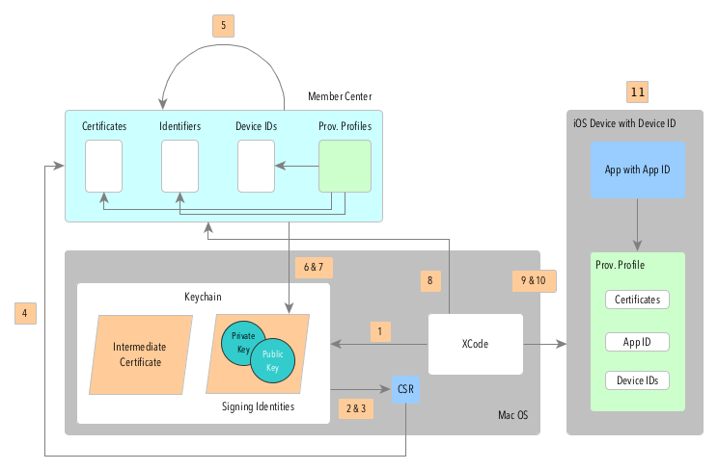
What is code signing?
Apple’s code signing diagram:
Notes:
B

Slide 15
What is code signing?
Apple’s code signing steps:
Xcode will be installed and the Intermediate Certificate will be pushed into the Keychain Certificate Signing Request (CSR) will be created.
Private Key will be generated along the CSR creation and stored in the Keychain.
CSR will be uploaded to the Member Center.
Apple will proof everything and issue the Certificate.
Notes:
B

Slide 16
What is code signing?
Apple’s code signing steps:
Certificate will be downloaded to your Computer.
The Certificate will be pushed into the Keychain and paired with the private key to form the Code Signing Identity.
The Provisioning Profile will be created using a Certificate, App ID and Device Identifiers and downloaded by Xcode
Xcode will sign the App and push Provisioning Profiles onto the Device.
Notes:
B

Slide 17
What is code signing?
Apple’s code signing steps:
iOS will proof if everything is correctly configured. That means that the Provisioning Profile should include the Certificate you used to sign the App, your Device UDID and the correct App ID.
Your App should be running and available on the App Store.
Notes:
B

Slide 18
What is code signing?
Google’s code signing steps:
Google’s app signing is simple.
Generate a keystore with developer’s information.
Use the keystore to generate the app!
Notes:
B

Slide 19
Exporting an expo build
The expo build provides the code signing and build exports for both Google and iOS.
That saves a lot of trouble as compared to native app deployment.
Let’s go through the steps of exporting builds for Google and Apple using expo build.
Notes:
B

Slide 20
Exporting an expo build
There are TWO (2) parts to exporting a build.
Build standalone apps an identify requirements
App signings (Android and iOS)
Notes:
B

Slide 21
Exporting an expo build
Build standalone apps an identify requirements
First of all, you will need developer accounts.
An Apple Developer account is needed to build an iOS standalone app, and to publish it to the stores.
In case of Android, it looks a bit different. You need a developer account only to submit an app to the store, and it is not required to build it.
Notes:
B

Slide 22
Exporting an expo build
Build standalone apps an identify requirements
Developers accounts:
iOS – build and publish app
Android – publish app
Notes:
B

Slide 23
Exporting an expo build
Build standalone apps an identify requirements
Expo builds app bundles in the cloud, thus we will be primarily using expo cli to export builds.
Notes:
B

Slide 24
Exporting an expo build
App signings
The first step before publishing the Expo app is adding the build information to the app.json file.
The required items are:
Name
Icon
Version
You also have to add a bundle identifier and build number for iOS and package name and version code for android apps.
Notes:
B

Slide 25
Exporting an expo build
App signings
The first step before publishing the Expo app is adding the build information to the app.json file.
The required items are:
Name
Icon
Version
You also have to add a bundle identifier and build number for iOS and package name and version code for android apps.
Notes:
B

Slide 26
Exporting an expo build
App signings
Once the app.json is completed. Run expo build to build apps for both environments or specify one by adding Android, iOS platform.
expo build //build app for both platforms expo build:android //build app for android expo build:ios //build app for ios
Notes:
B

Slide 27
Exporting an expo build
Let’s go through a demonstration example on how to export builds for both Android and iOS.
Notes:
B

Slide 28
That’s all for today!
If you have any questions, please feel free to reach out to me at this email.
kydsim001@mymail.sim.edu.sg
Notes:
B

Slide 29
END OF LESSON

